Slide 1
Data Mining -
Thyroid classification
By Rehan Ahmed, Hassan Saeed

Slide 2
Dataset
Prediction task is to determine whether a person has thyroid or not.
Data contains 3772 instances, mix of continuous, categorical and discrete values (train=2800, test=972)
Source: http://archive.ics.uci.edu/ml/machine-learning-databases/thyroid-disease/

Slide 3

Methodology

Slide 4
Dataset
There are 30 variables.
Dependent variable is: result
Result= negative | increased binding protein | decreased binding protein
We have to predict whether a person has thyroid or not.

Slide 5
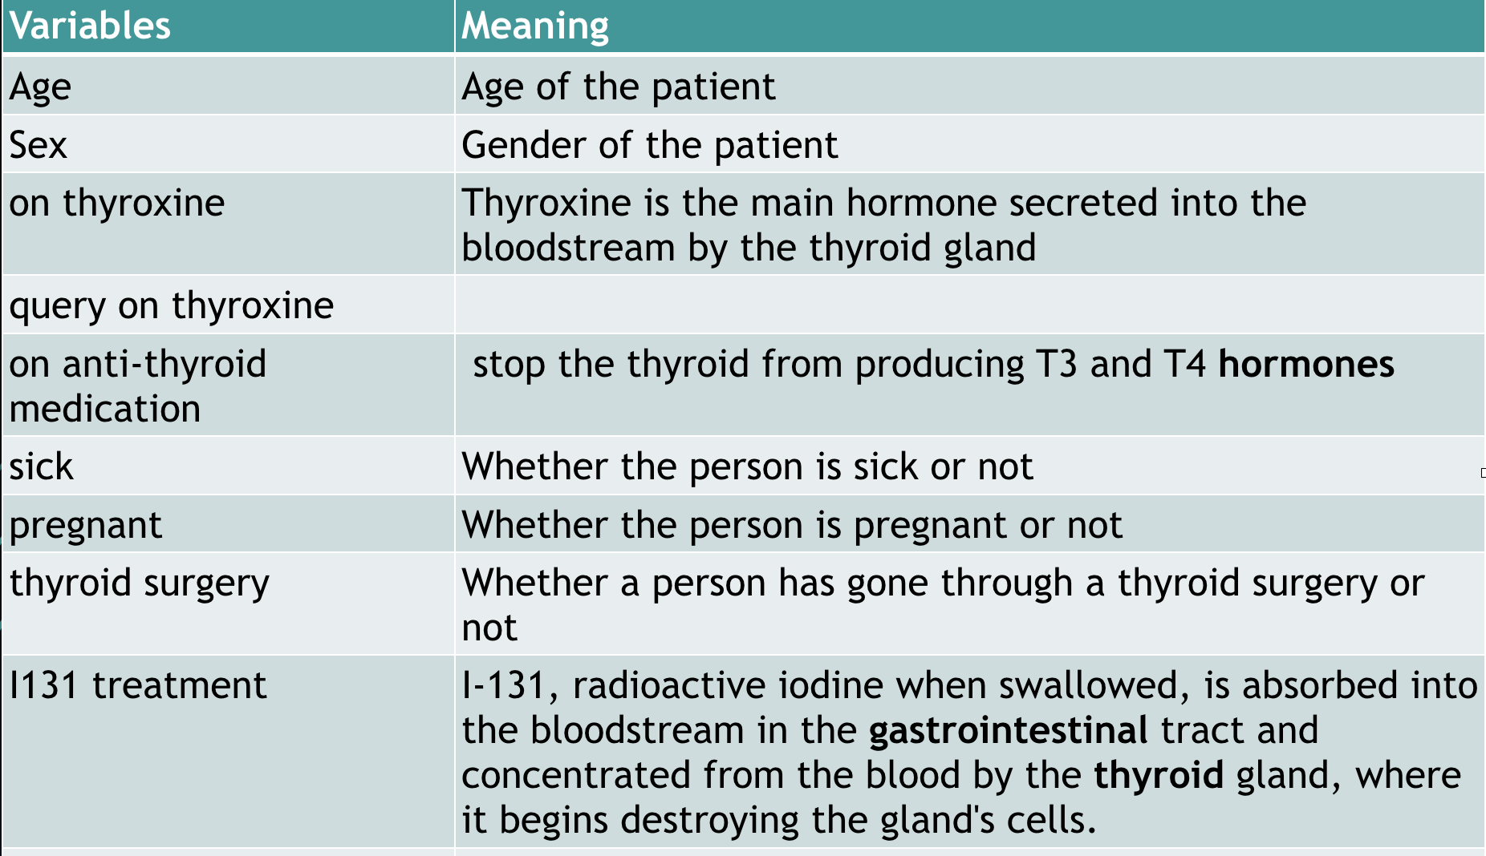
Attributes

Slide 6
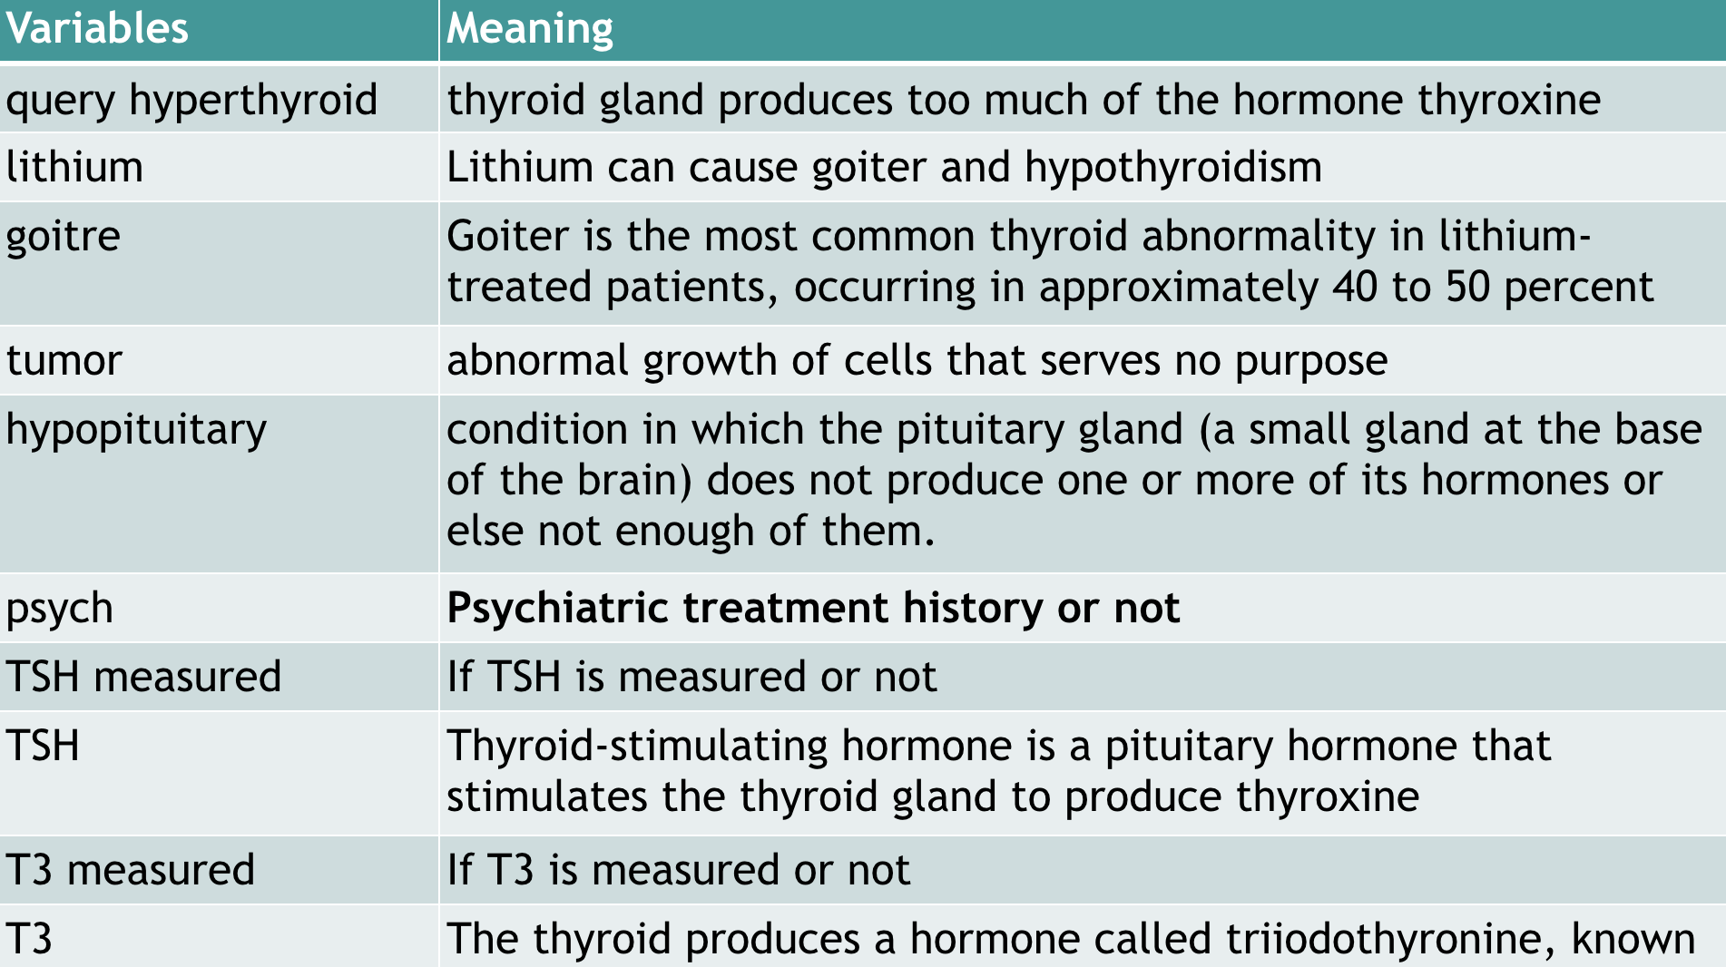
Attributes

Slide 7
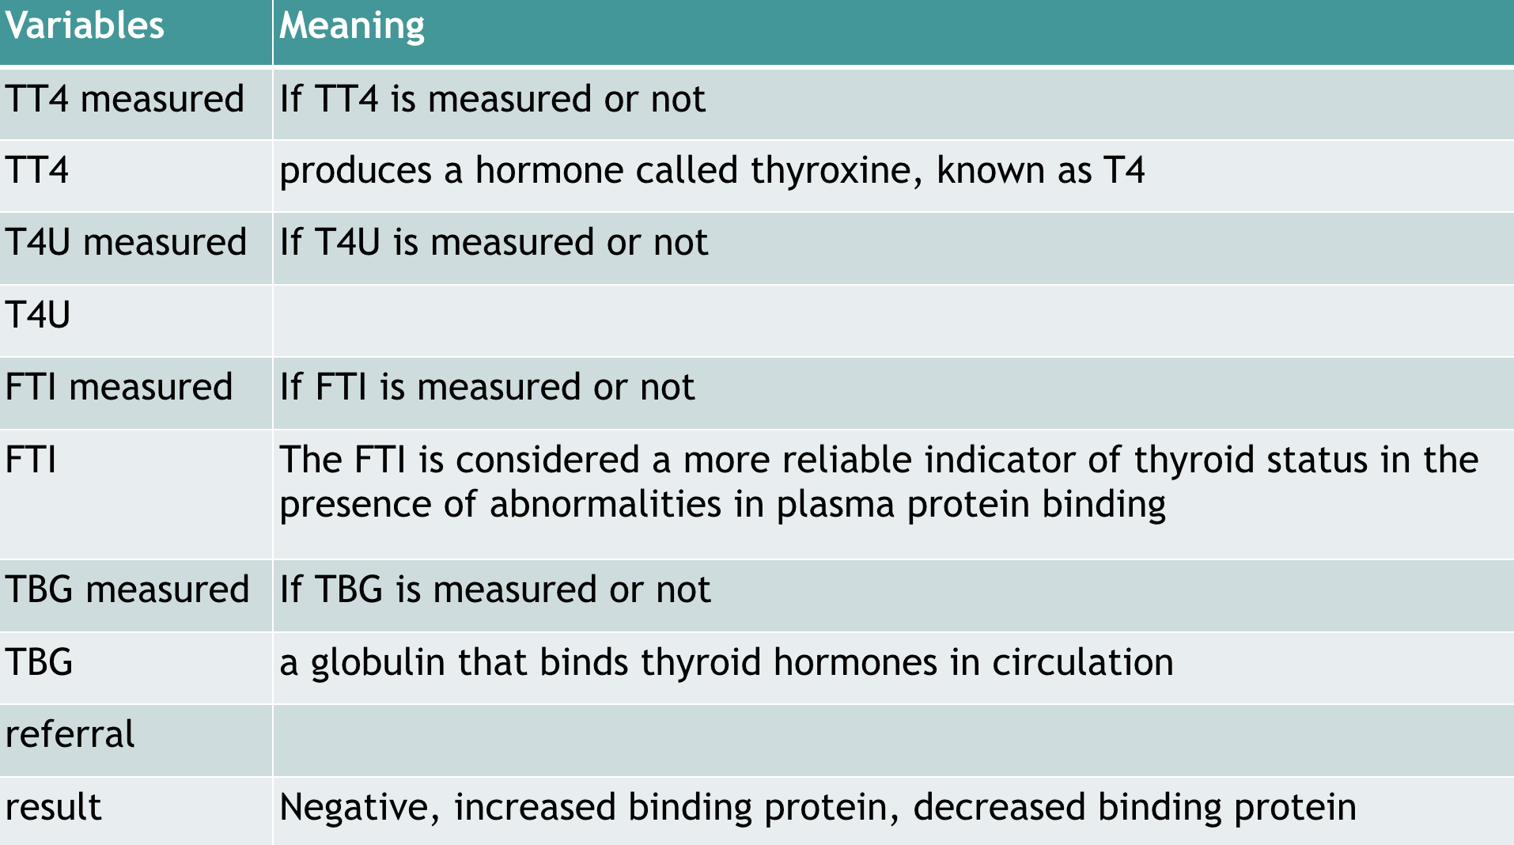
Attributes

Slide 8
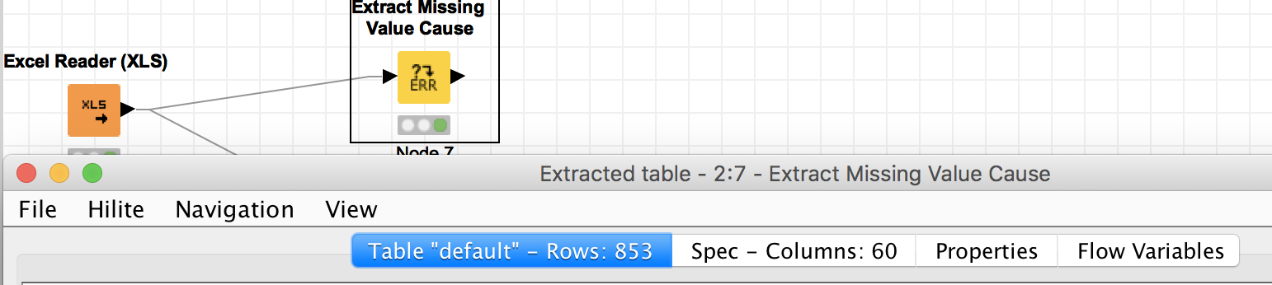
Data Cleaning
The data was pretty clean and consistent
Only had to deal with missing values
There were 800 rows containing missing values

Slide 9
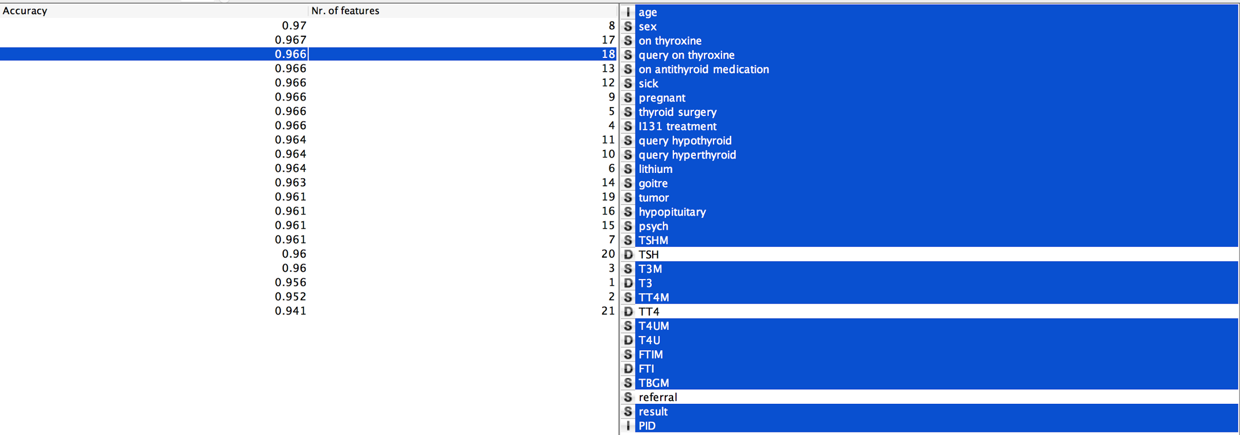
Missing Values
We first tried to remove all the rows containing missing values
Feature Selection suggested choosing the following 18 features

Slide 10
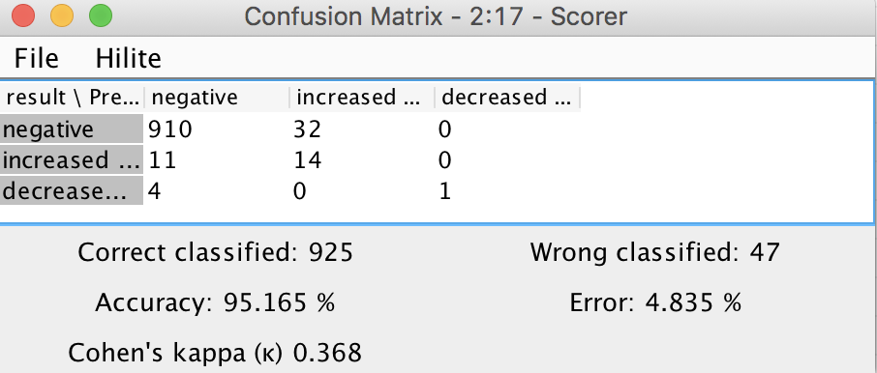
Missing Values
Accuracy (Naive-Bayes):

Slide 11
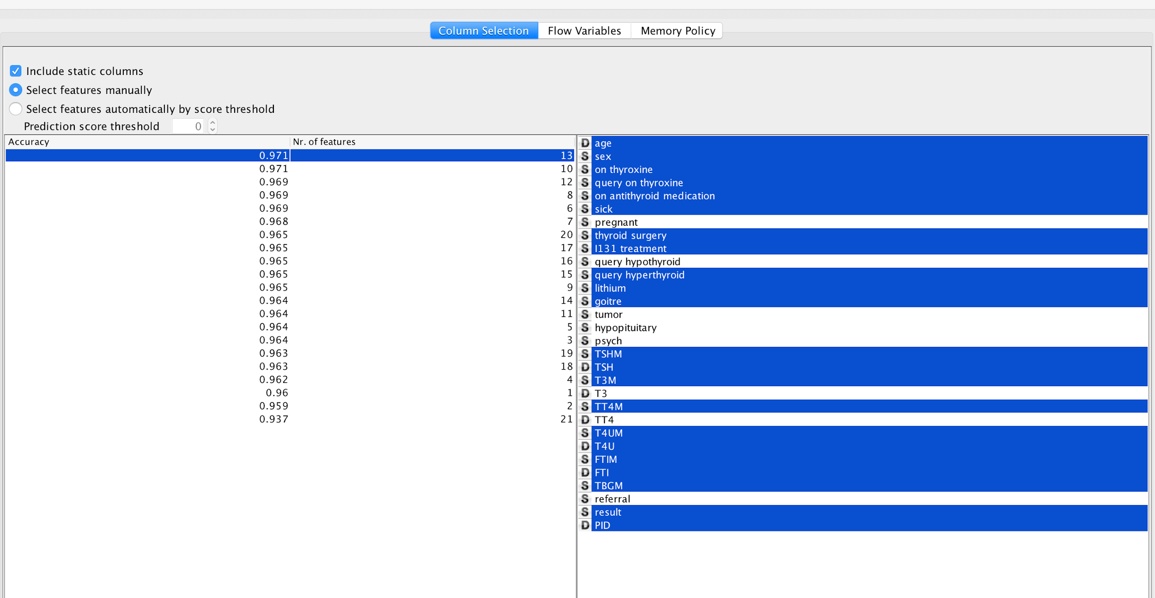
Missing Values
We then replaced missing values with median/most frequent values
Feature Selection suggested choosing the following 13 features

Slide 12
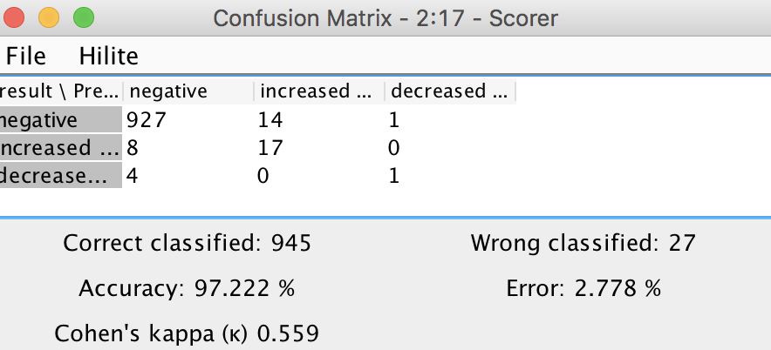
Missing Values
Accuracy (Naive-Bayes):

Slide 13
Missing Values
Therefore, we chose to replace missing values with median/most frequent for further models

Slide 14
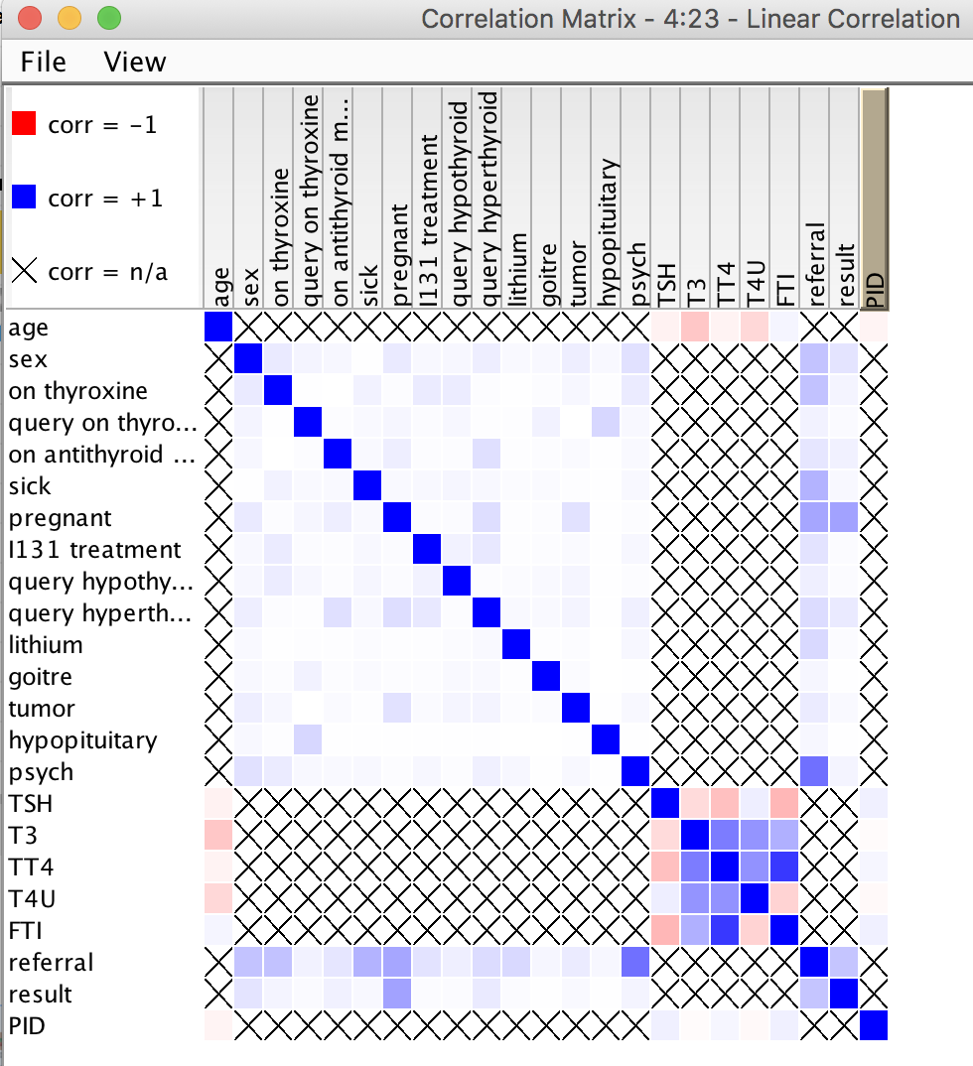
Corelation

Slide 15
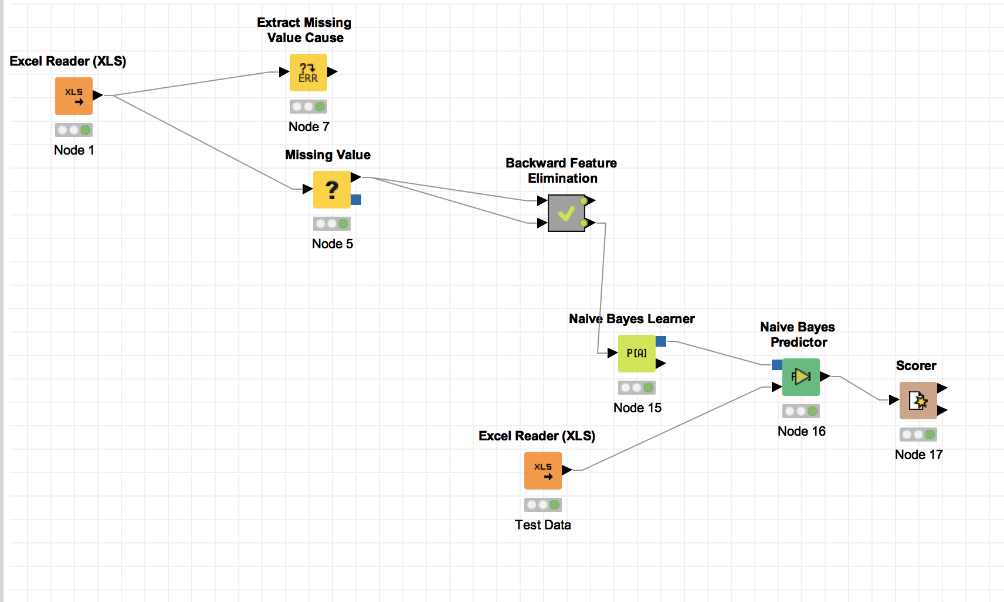
Work Flow - Naive Bayes

Slide 16
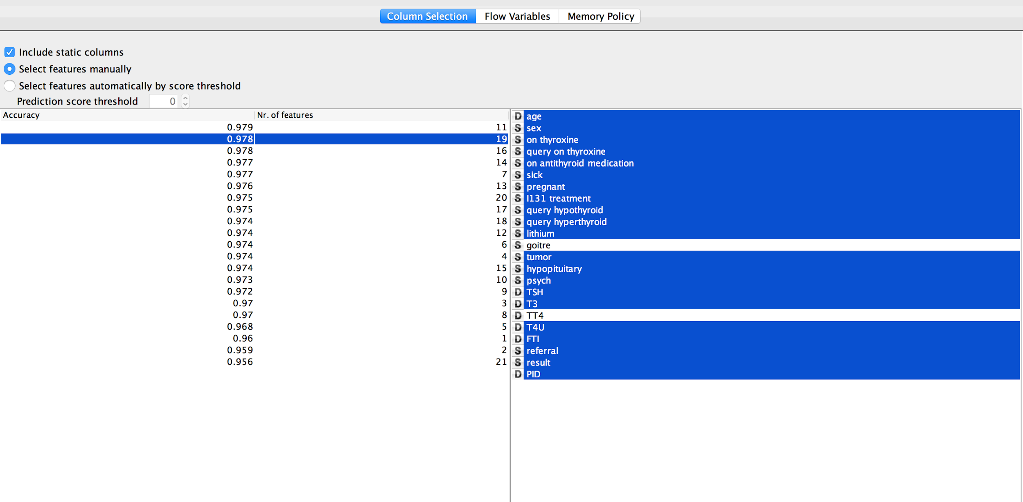
Decision Tree
Feature selection using decision tree

Slide 17
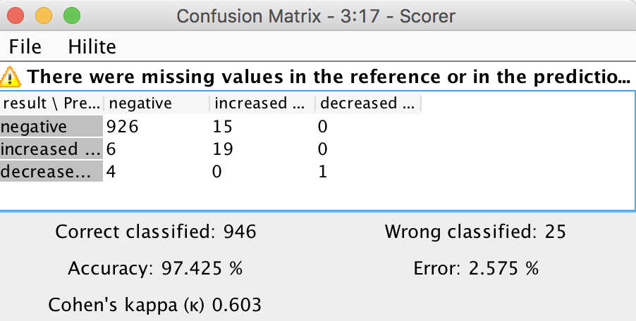
Prediction

Slide 18
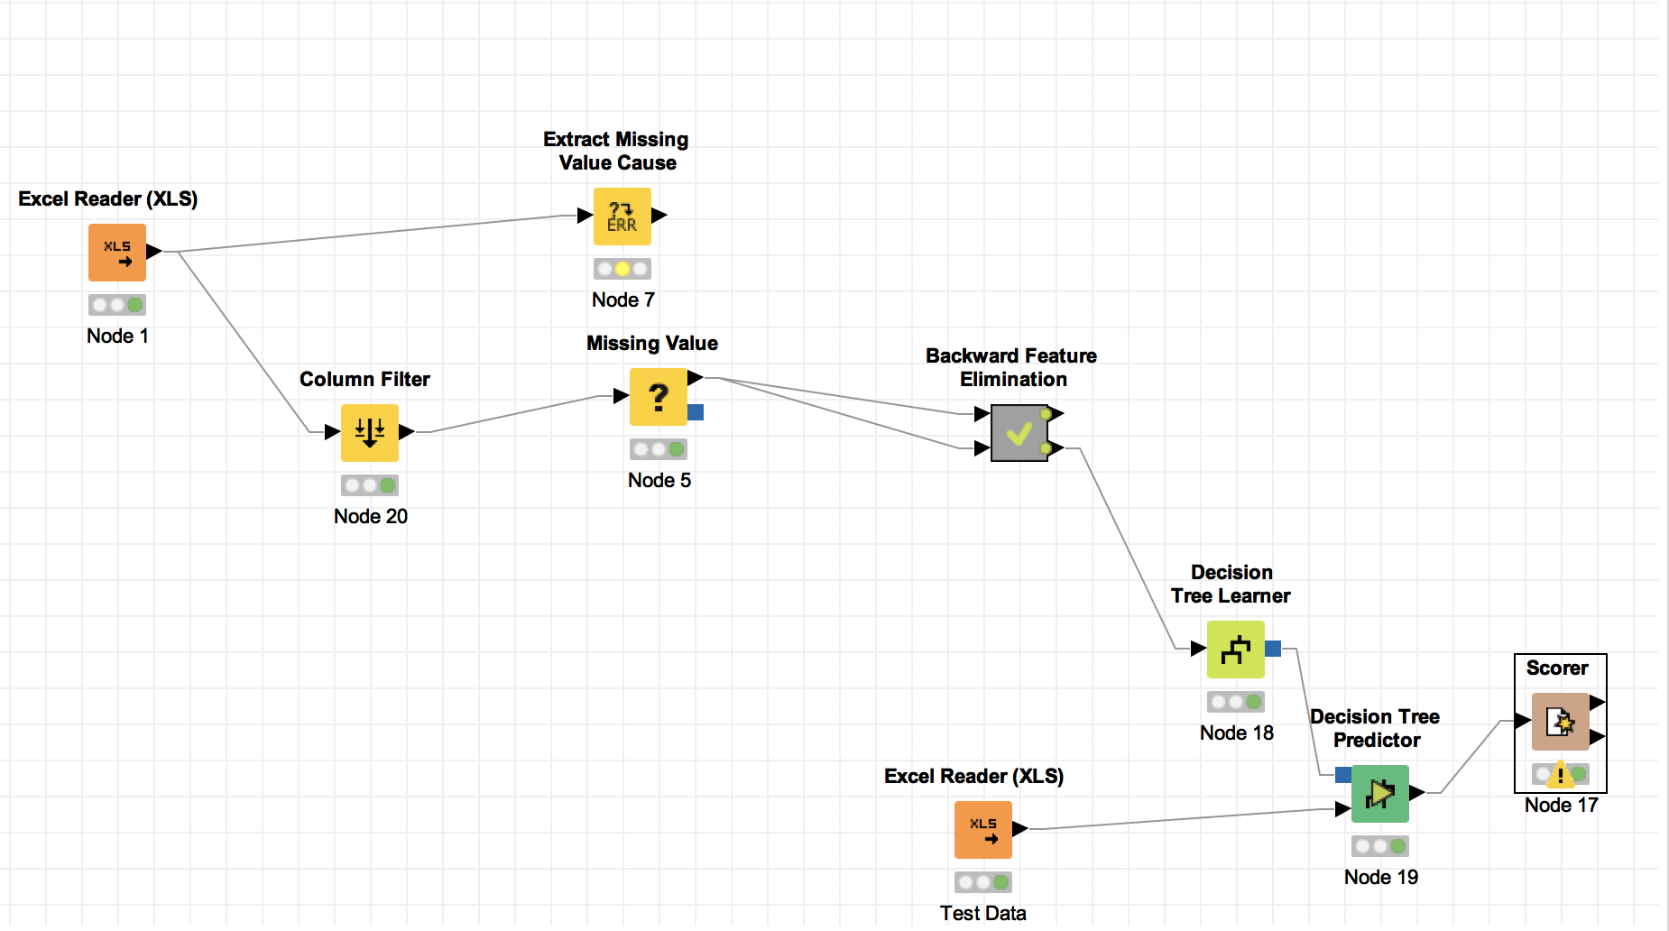
Work Flow - Decision Tree

Slide 19
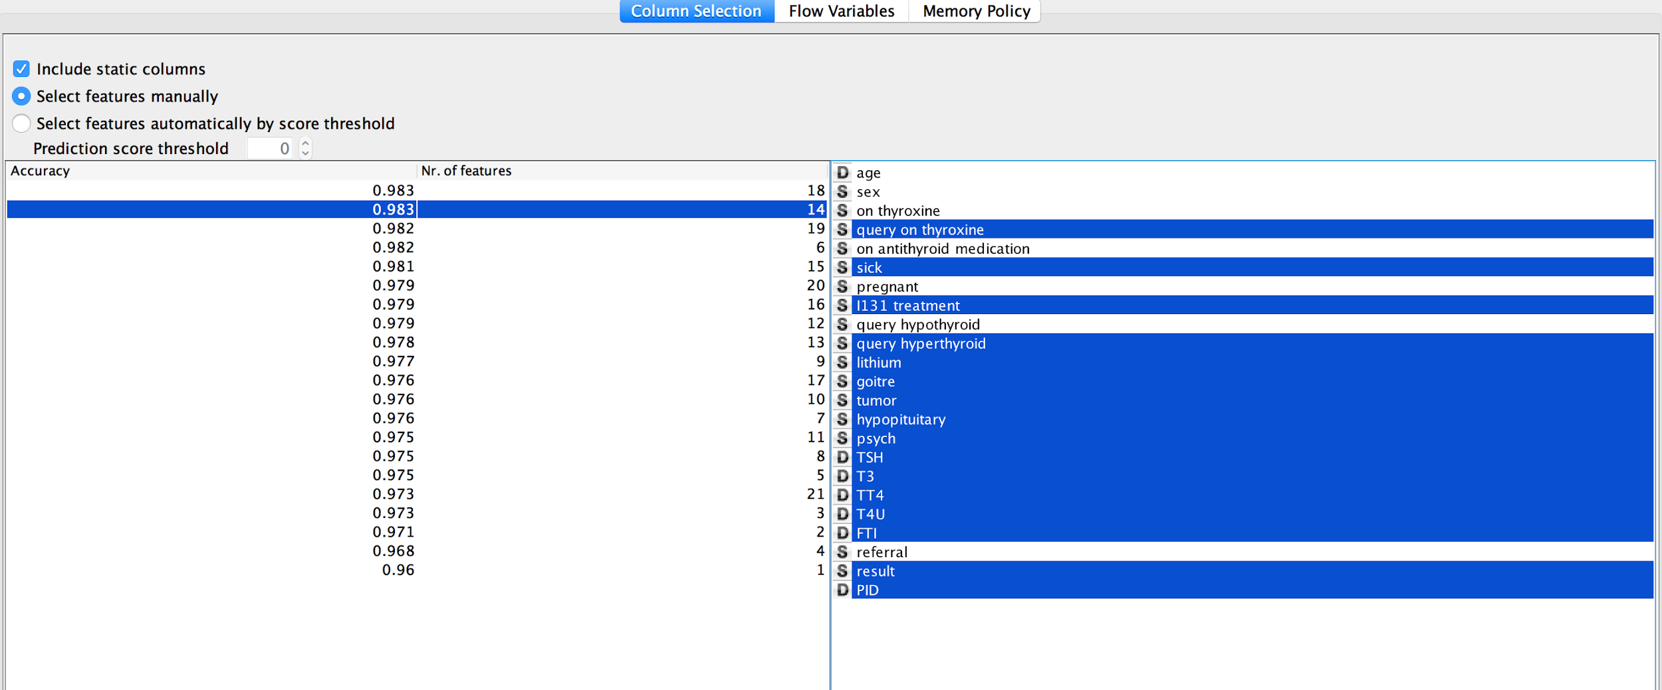
Random Forest
Feature selection using random forest

Slide 20
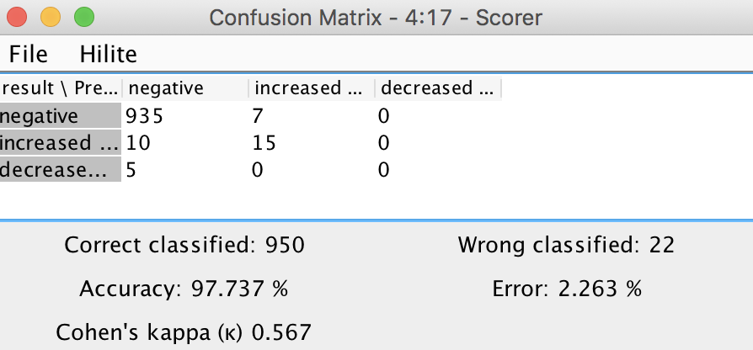
Prediction

Slide 21
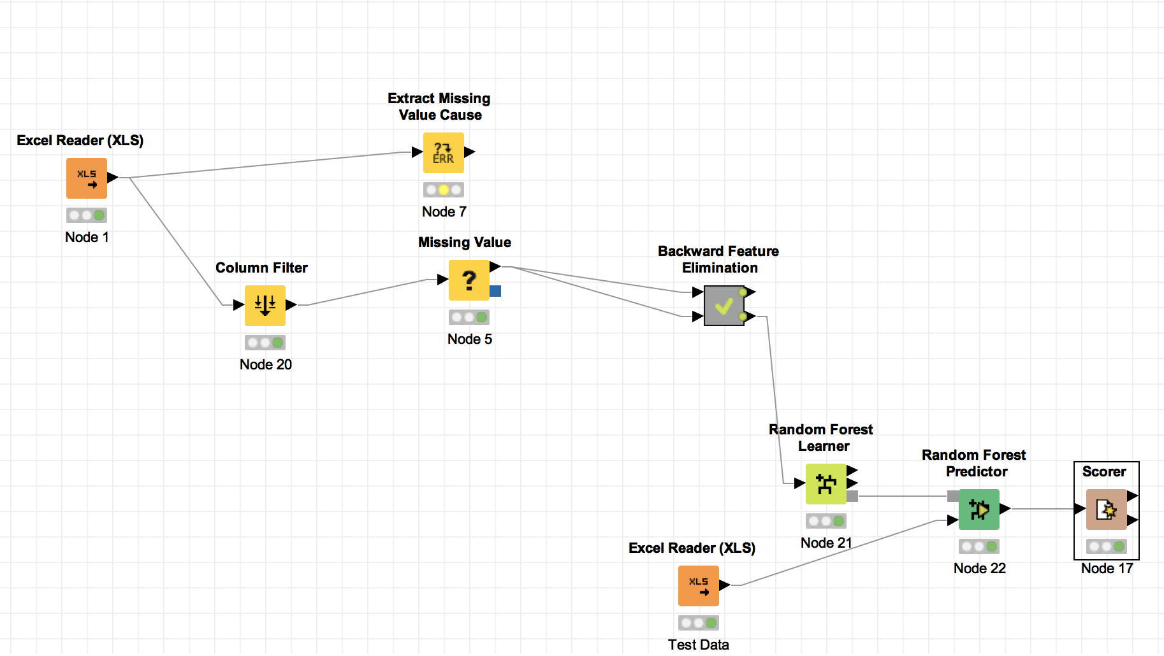
Work Flow - Random Forest

Slide 22
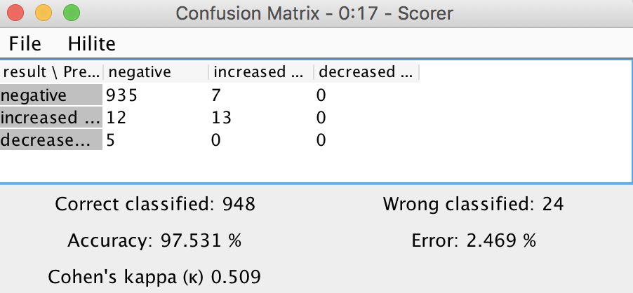
Prediction

Slide 23
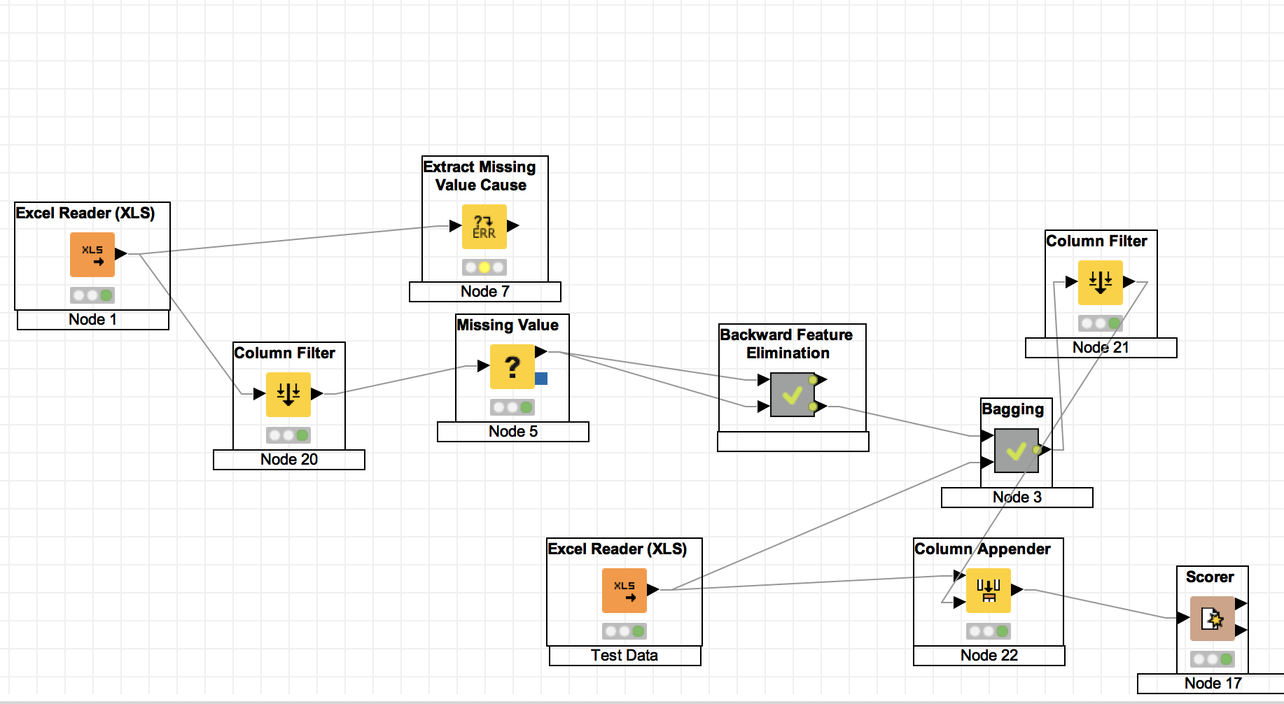
Work Flow - Boosting

Slide 24
Conclusion
Naive-Bayes with null removed : 95.1%
Naive-Bayes: 97.2%
Decision Tree: 97.4%
Random Forest: 97.7%
Boosting with Random Forest: 97.5%

